Slide 1




Modeling Shallow Pore Water Chemistry above Marine Gas Hydrate Systems
Sayantan Chatterjee, Gerald Dickens, Gaurav Bhatnagar, Walter Chapman, Brandon Dugan, Glen Snyder, George Hirasaki
Rice University, Houston, Texas, USA
April 23, 2012
Rice University
Consortium on Processes
in Porous Media
DE-FC26-06NT 42960

Slide 2
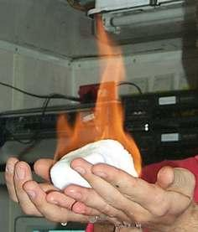
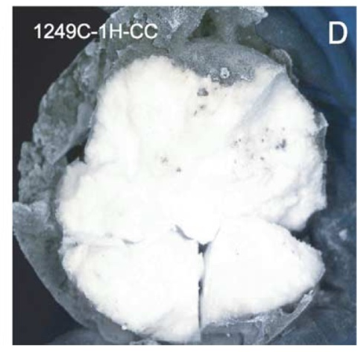
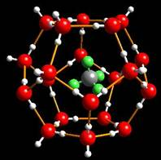
Gas hydrates
Cage structure “Ice that burns” Core sample
Source: USGS
Source: USGS
Torres et al., Earth Planet. Sci. Lett., (2004)
Clathrates Ice-like solids Guest molecules (e.g., CH₄) encapsulated in H₂O cages | Stability - High pressure - Low temperature - Low salinity | Occurrence Marine sediments along continental margins - Permafrost regions

Slide 3
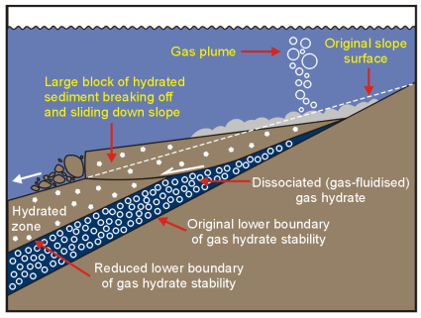
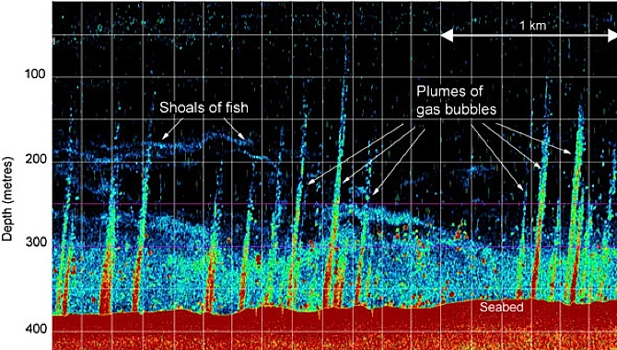
A fundamental understanding of the dynamics of gas hydrate systems
Motivation
Potential energy resource
Recoverable and
Non-recoverable fossil fuels
(coal, oil, natural gas), 5,000
Subsea geohazard Global climate change
McIver, AAPG (1982) Westbrook et al., Geo. Res. Lett., (2009)

Slide 4





Schematic of hydrate formation and burial
Phase relationships
Components
Transient state
Steady state
Organic carbon
Sediment flux
Hydrotherm
Seafloor
SO₄²⁻
α_{o}
TOC
T₀
SO₄²⁻ reduction zone
Depth
CH₄
Solubility
Hydrate
CH₄ 3-phase equilibrium
Dissolved
gas
Hydrate layer
extending downwards
Geotherm
GHSZ
Hydrate dissociation due to burial below the GHSZ
Base of GHSZ
Transient state
Sedimentation fluid flux
Free gas recycling
Steady state
Free gas
External fluid flux
0 10 20 30
0 100 200 300
Temperature (ºC)
Concentration (mM)
Subsidence
Subsidence
Geologic time (Myr)
Bhatnagar et al., Am. J. Sci., (2007); Chatterjee et al., (2012) to be submitted

Slide 5
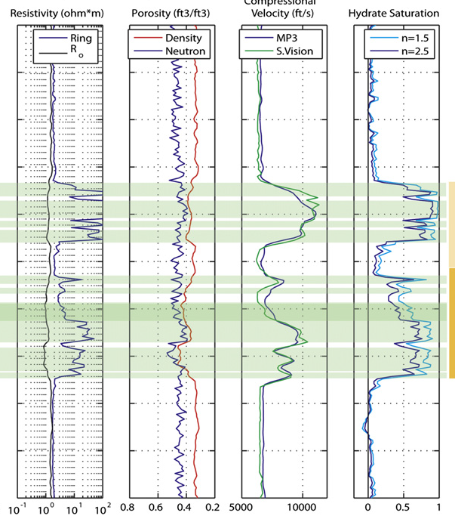
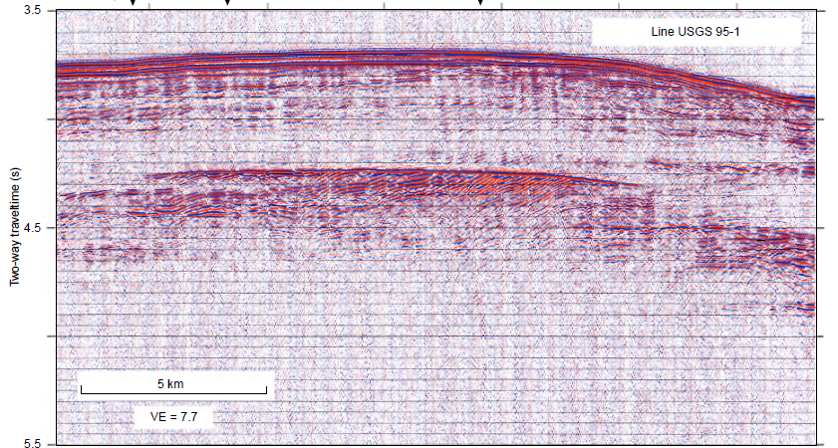
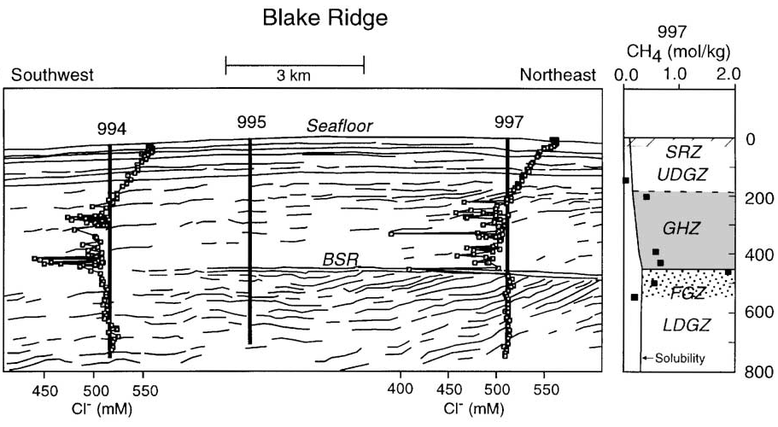
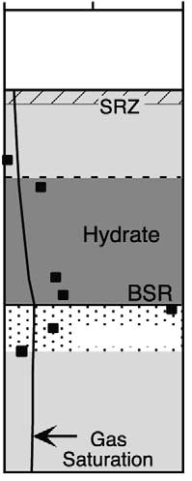

Methods to quantify gas hydrate amount and distribution
994 995 997
Paull et al., ODP Init. Repts., 164, (1996)
Free gas
Boswell et al., Mar. Pet. Geo., (2011)
Dickens., Org. Geochem., (2001)

Slide 6
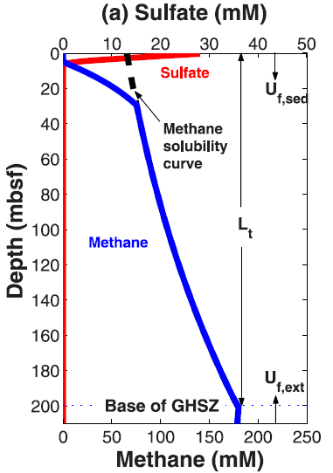
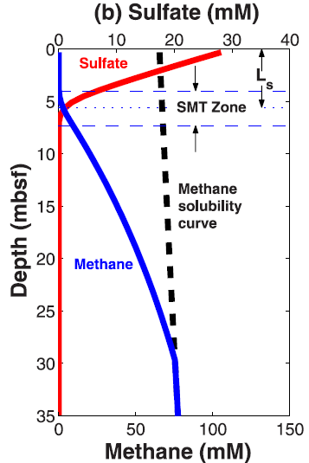
Gas hydrate systems and the SMT
SMT: Sulfate Methane Transition
Bhatnagar et al., Geo. Res. Lett., (2008)

Slide 7
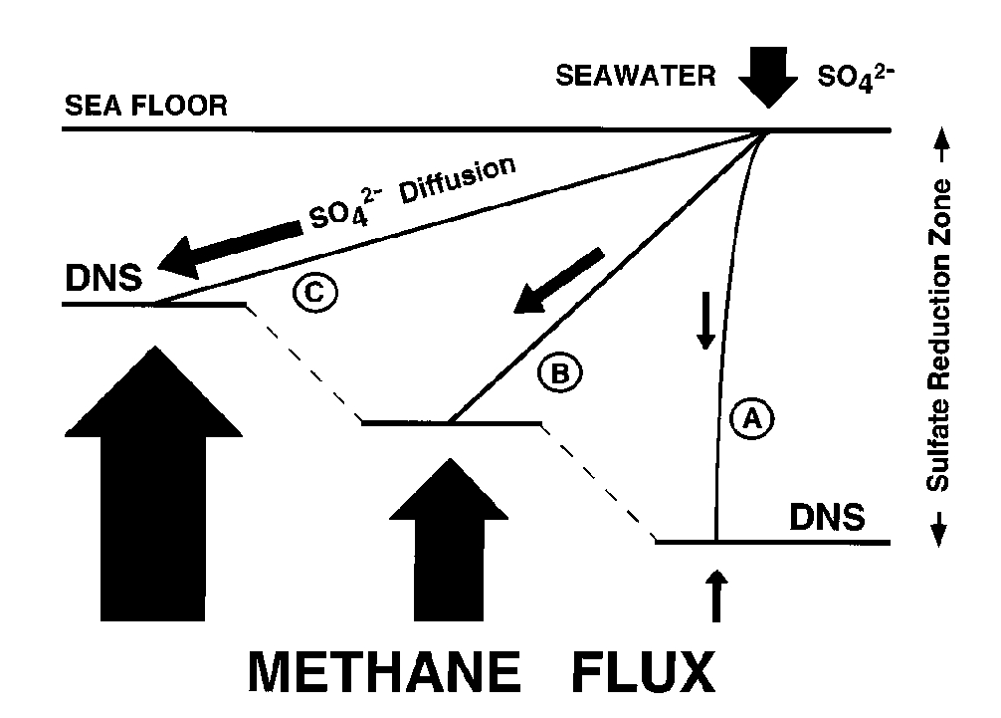
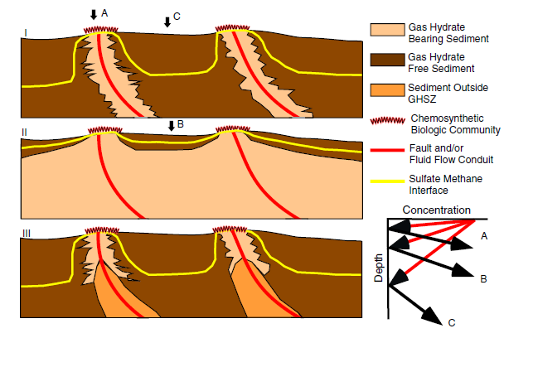
SMT depth inversely proportional to upward methane flux
SMT
Depth below seafloor
SMT
Fault line
SMT
Chemosynthetic
community
Gas hydrate
bearing sediment
Gas hydrate
free sediment
Borowski et al., Geology, (1996)
Paull et al., Geo-Mar. Lett., (2005)

Slide 8
Key model features
  CH₄ solubility and phase equilibrium curves
  Sedimentation and compaction
  Mass balance equations:
    Sediment
    Water
    Organic carbon
    Methane (CH₄)
    Sulfate (SO₄²⁻)
    Bicarbonate (HCO₃⁻)
    Calcium (Ca²⁺)
    Carbon isotopes of CH₄ and HCO₃⁻
  CH₄ sources:
          In situ methanogenesis (biogenic)
          Deep external sources (thermogenic)
  Advection, diffusion and reaction
PDEs solved using
finite-difference method
(Explicit and implicit schemes)

Slide 9
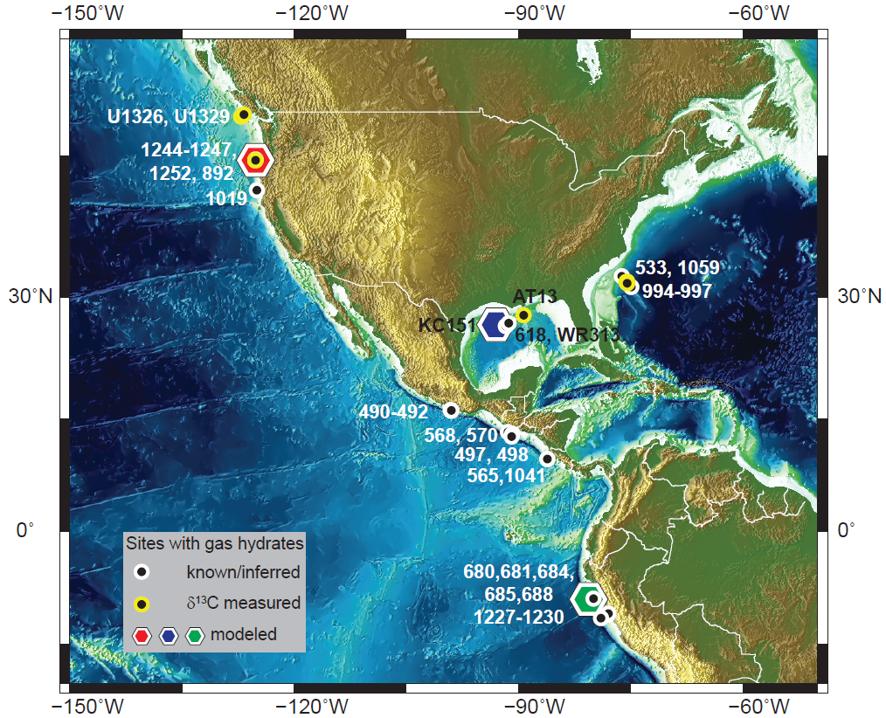
Geologic sites known/inferred for gas hydrates
Chatterjee et al., J. Geophys. Res., (2011)

Slide 10
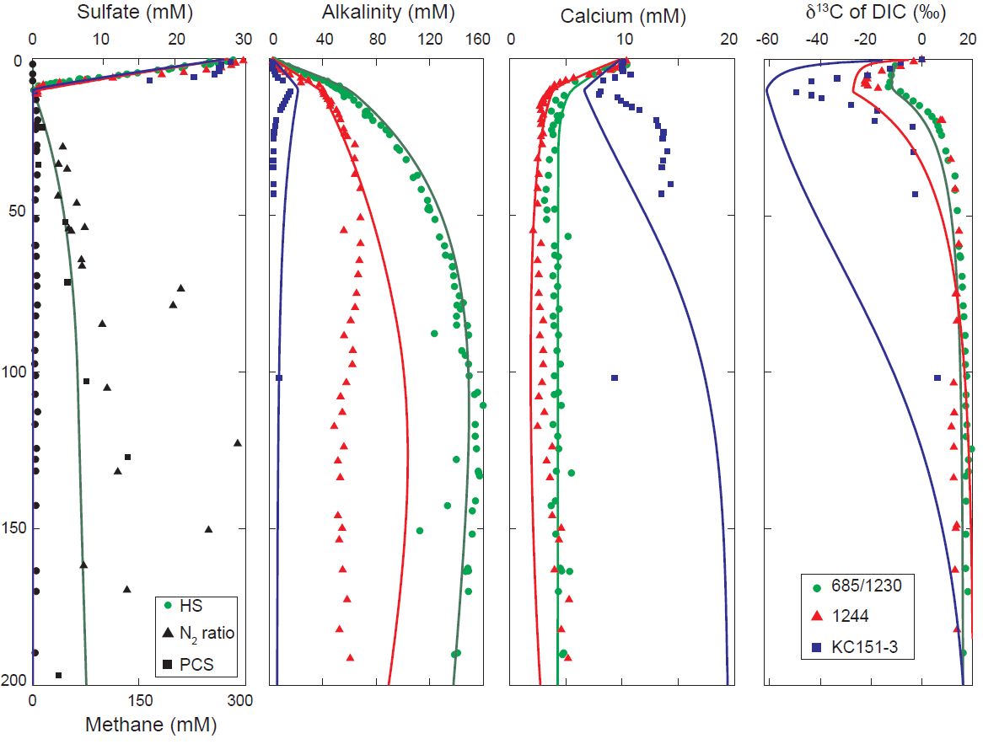
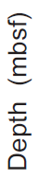
Modeling pore water chemistry at 3 sites
Chatterjee et al., J. Geophys. Res., (2011)

Slide 11
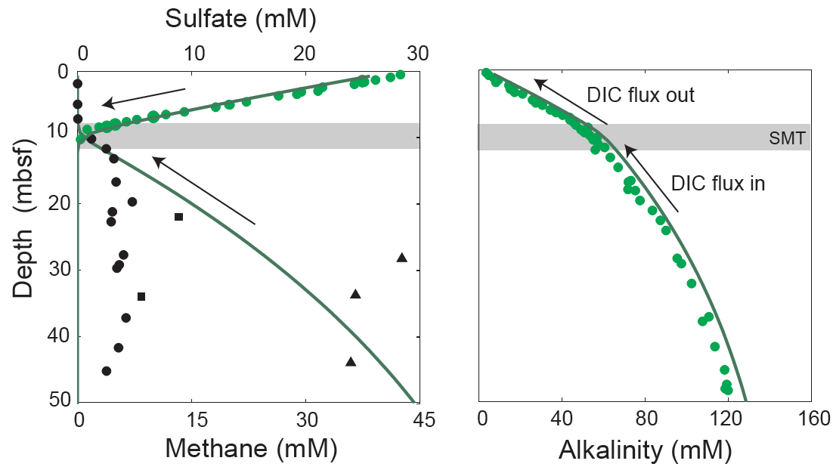
Flux balance across the SMT using steady-state simulations
At the SMT:
Diffusive flux
Advective flux = 0
Chatterjee et al., J. Geophys. Res., (2011); Chatterjee et al., (2012) to be submitted

Slide 12
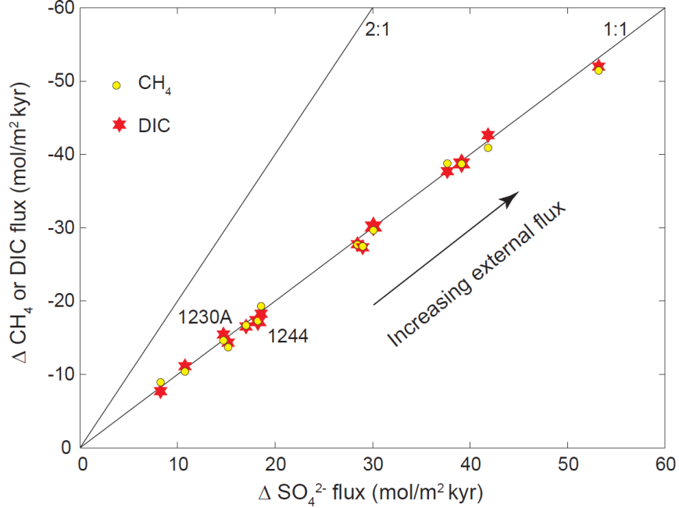
A 1:1 flux balance across SMT implies dominant AOM at the SMT
flux
  Anaerobic Oxidation of Methane (AOM)
flux
Chatterjee et al., J. Geophys. Res., (2011); Chatterjee et al., (2012) to be submitted

Slide 13
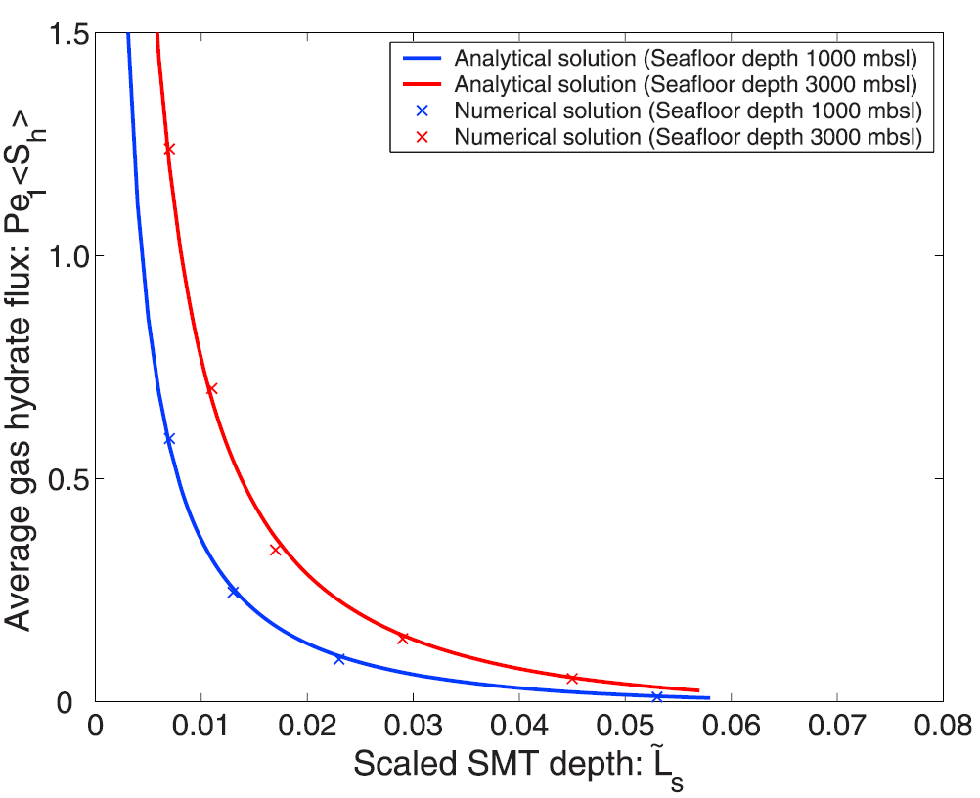
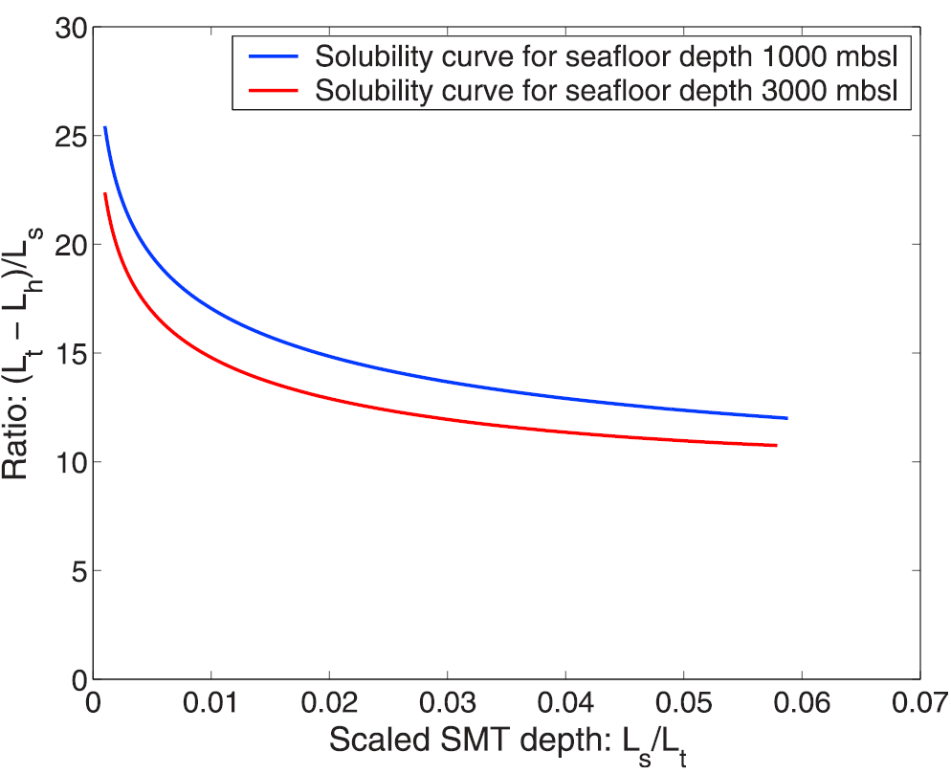
SMT depth: A useful proxy
Depth below seafloor
Pe₁<S_{h}>
SMT depth
Hydrate
saturation
Fault line
SMT
Chemosynthetic
community
Gas hydrate
bearing sediment
Gas hydrate
free sediment
Paull et al., Geo-Mar. Lett., (2005)
Normalized
Scaled SMT depth
SMT depth
Net fluid flux
Top of gas hydrate
Hydrate saturation <S_{h}>
“Rule of ten”
Top of hydrate / SMT
SMT depth
Top of gas hydrate
Bhatnagar et al., Geochem. Geophys. Geosyst., (2011)
Scaled SMT depth

Slide 14
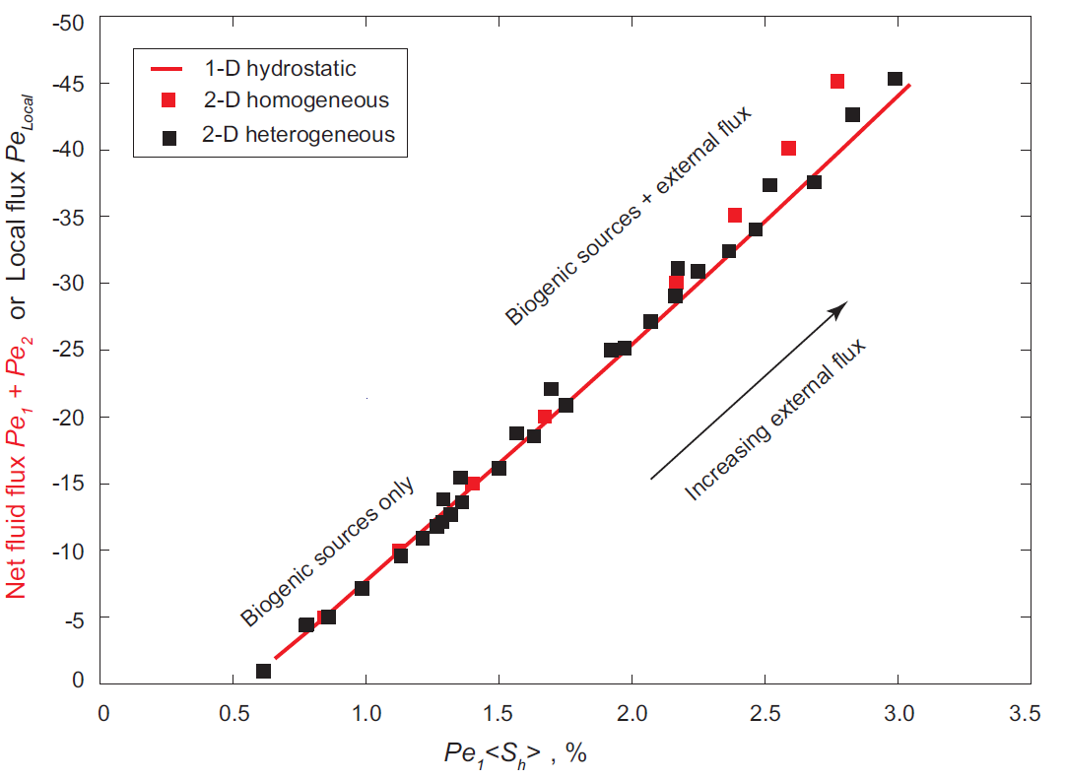
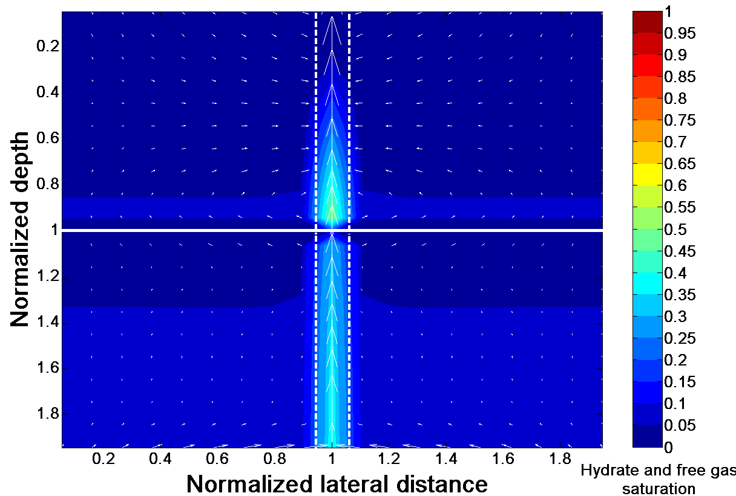
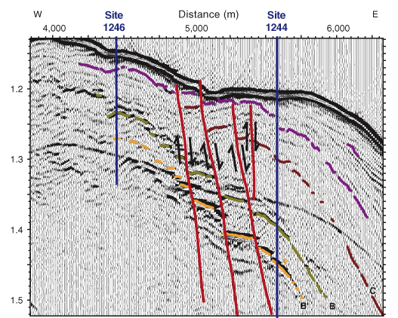
Modeling to quantify hydrate amount and distribution
Local fluid flux
Hydrotherm
Depth
T₃P
Geotherm
Base of GHSZ
Seafloor and geologic parameters
Top of gas hydrate
Local fluid flux
Local hydrate saturation
Local SMT depth
Base of hydrate stability
Pe₁<S_{h}>
Depth
“Rule of ten”
Top of hydrate / SMT
Scaled SMT depth

Slide 15
Conclusions
A 1:1 flux balance across the SMT implies dominant AOM at the SMT
SMT depth is a direct proxy to relate upward methane flux and hydrate saturation
An empirical “rule of ten” established to relate SMT depth and top of hydrate
Developed a model to evaluate hydrate amount and distribution

Slide 16
Back up slides

Slide 17
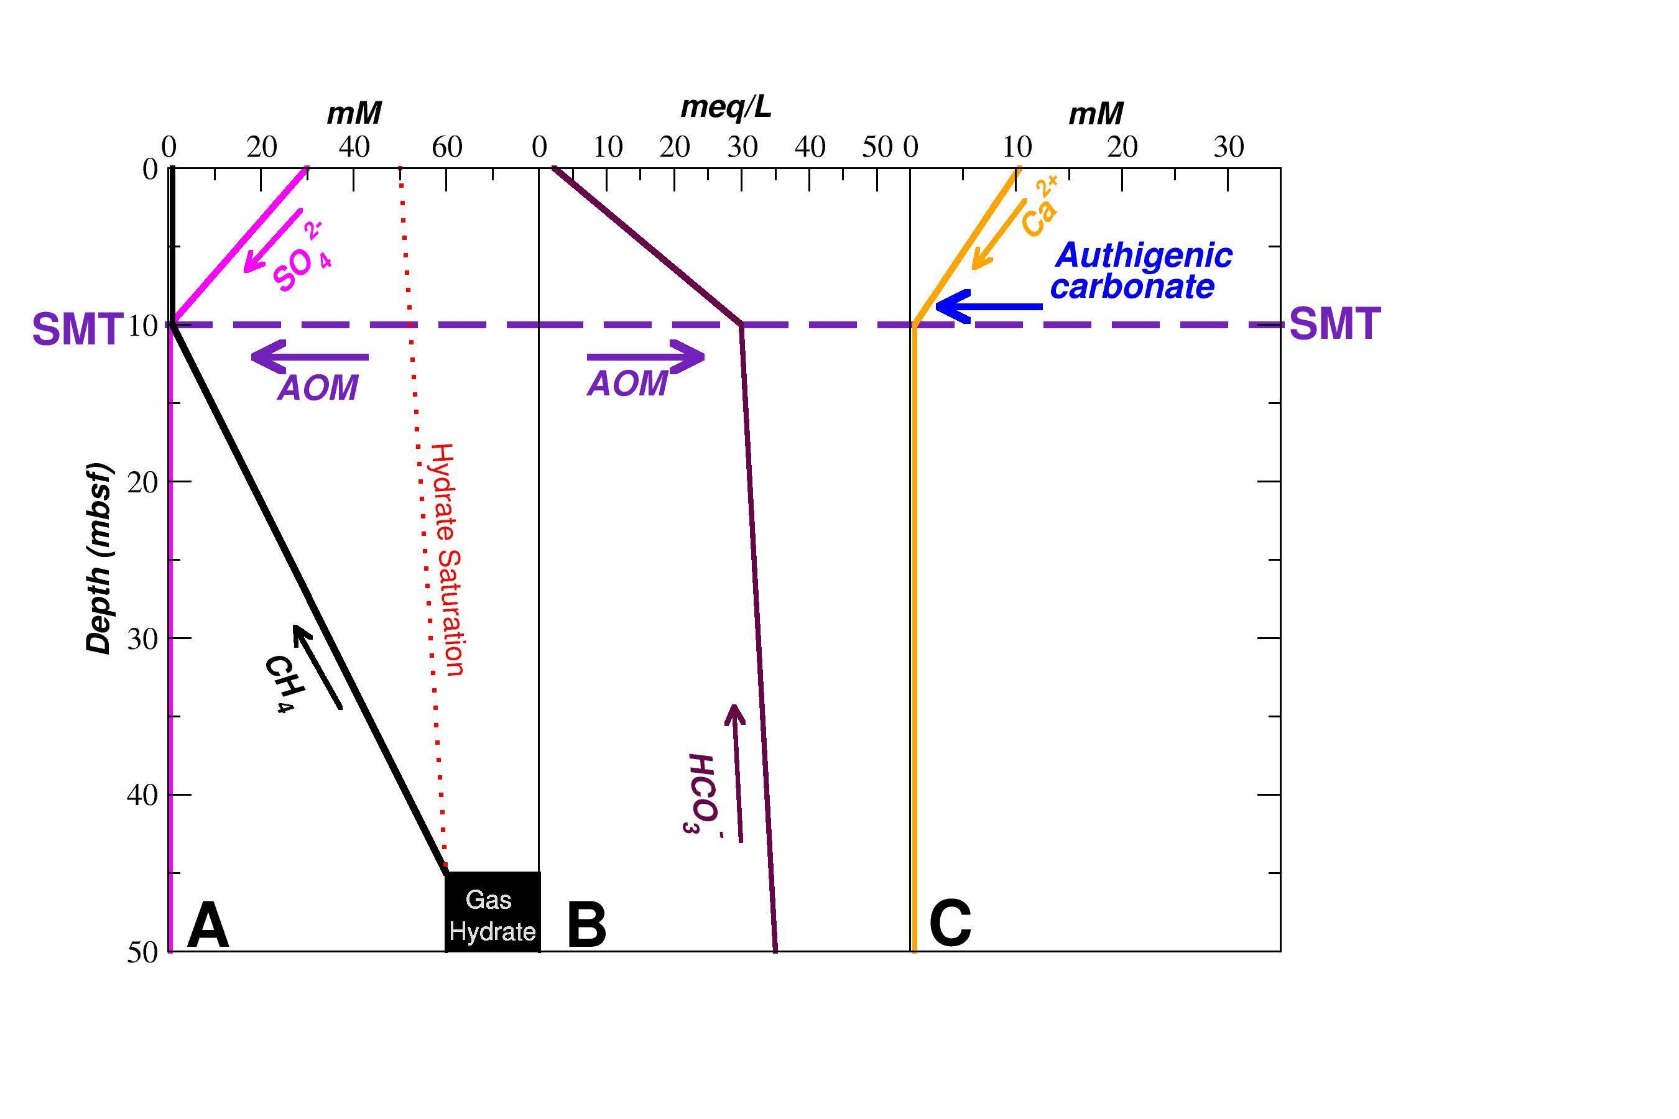
Pore water chemistry and reaction zones
Sulfate reduction zone
Methanogenesis
zone
Snyder et al., J. Geochem. Explor., (2007)

Slide 18
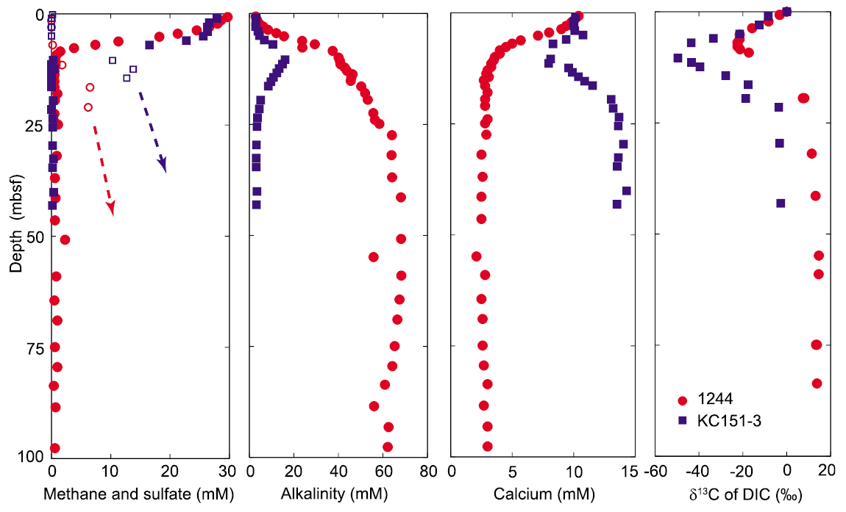
Pore water chemistry data: Sites 1244 and KC151
Chatterjee et al., J. Geophys. Res., (2011)

Slide 19
Pore water chemistry data: Site 1230
Chatterjee et al., (2012) to be submitted

Slide 20
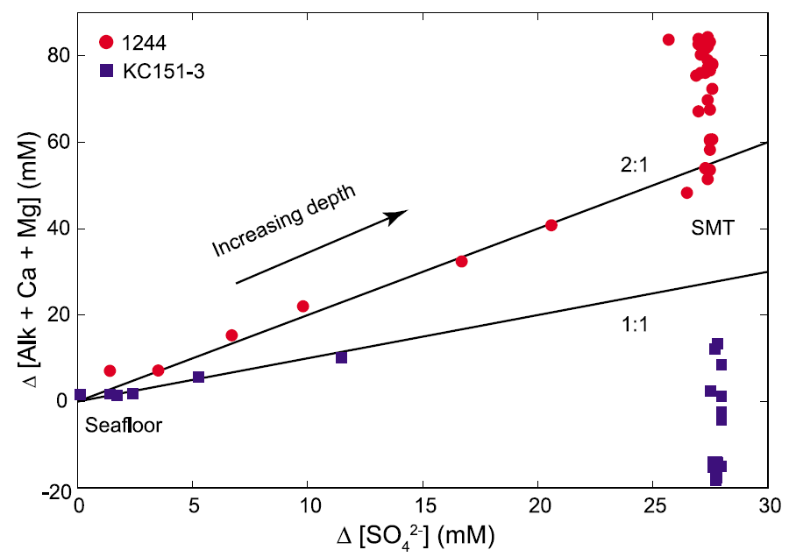
Concentration crossplot of DIC and SO₄²⁻
Chatterjee et al., J. Geophys. Res., (2011)

Slide 21
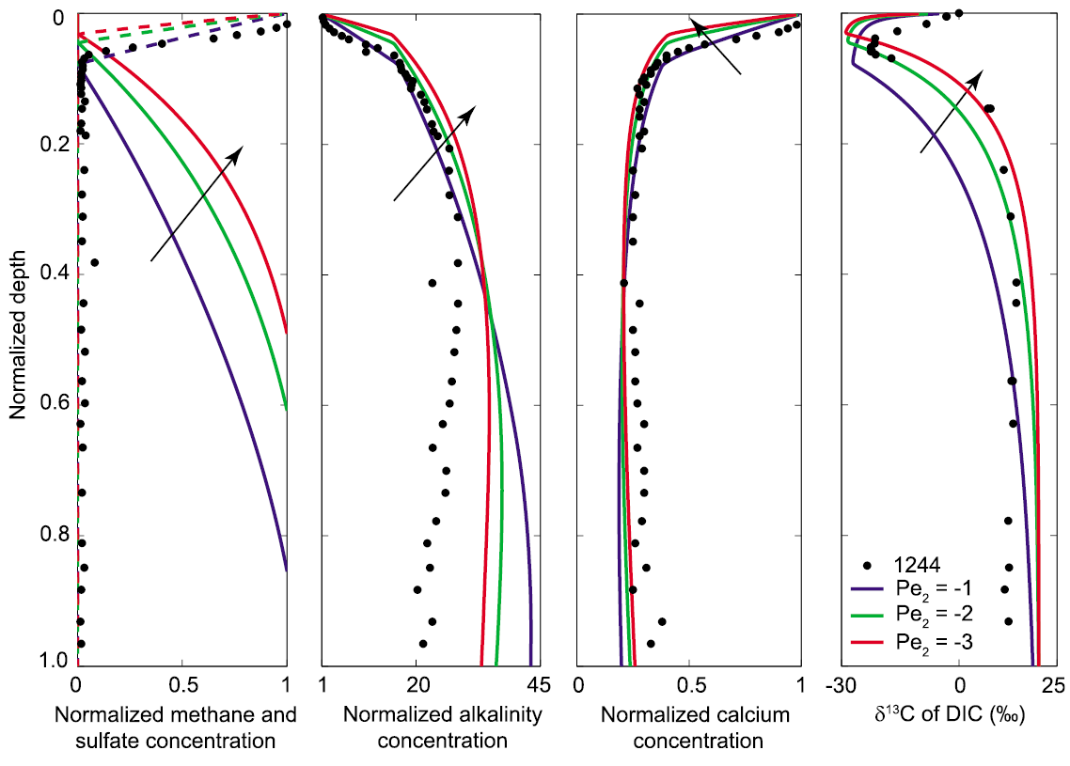
Steady state profiles: Site 1244
Chatterjee et al., J. Geophys. Res., (2011)

Slide 22
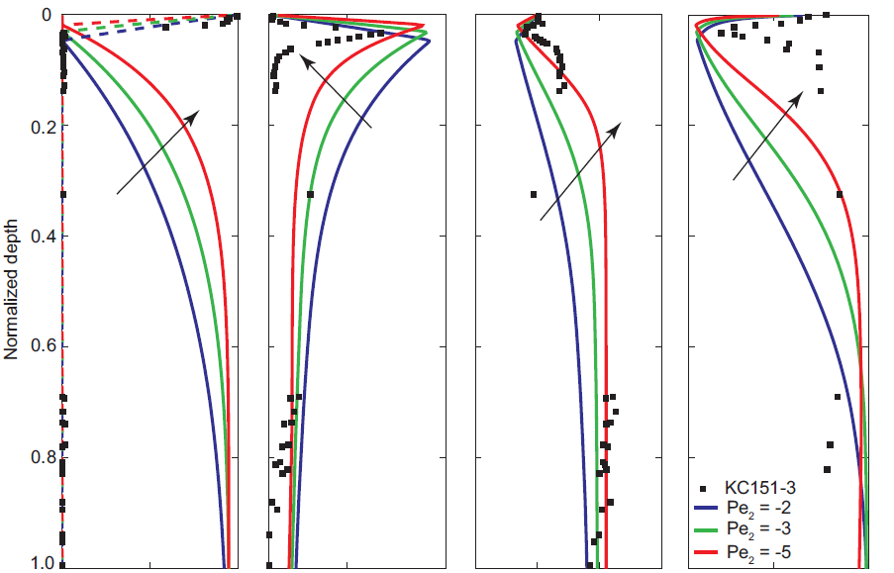
Steady state profiles: Site KC151
Chatterjee et al., J. Geophys. Res., (2011)

Slide 23
Physical property data: Site 1230
Pressure (MPa)
Chatterjee et al., (2012) to be submitted

Slide 24
Evidence of a 4.3 Myr hiatus implies Site 1230 is in transience
Hiatus

Slide 25
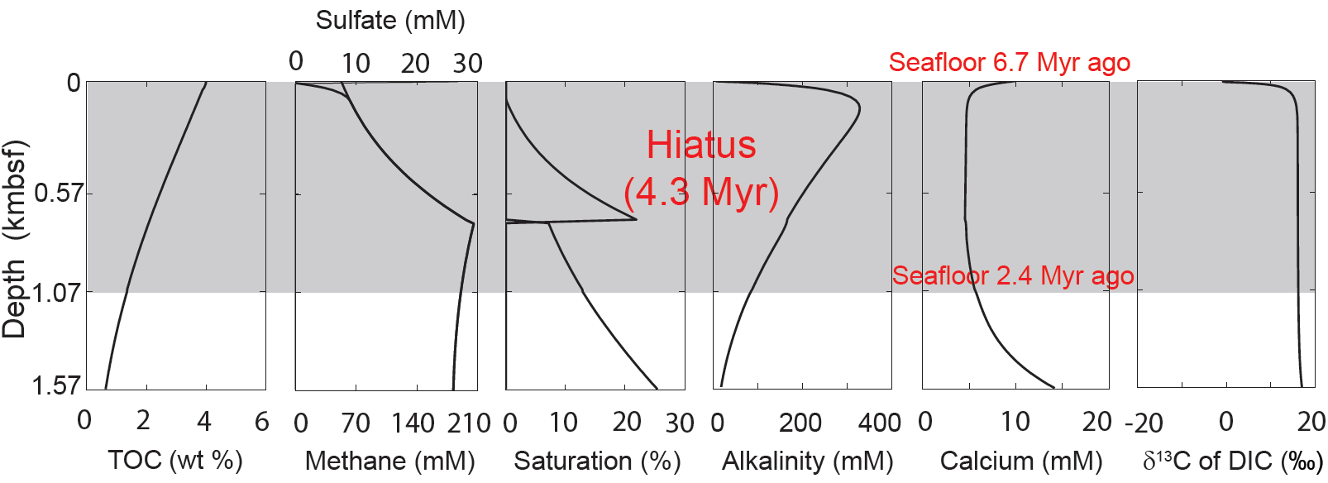
Pre-hiatus steady state profiles: Site 1230
Seafloor 2.4 Myr ago
Chatterjee et al., (2012) to be submitted

Slide 26
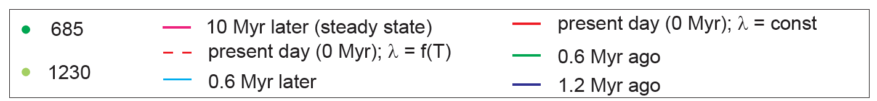
Transient state profiles: Site 1230
Chatterjee et al., (2012) to be submitted

Slide 27
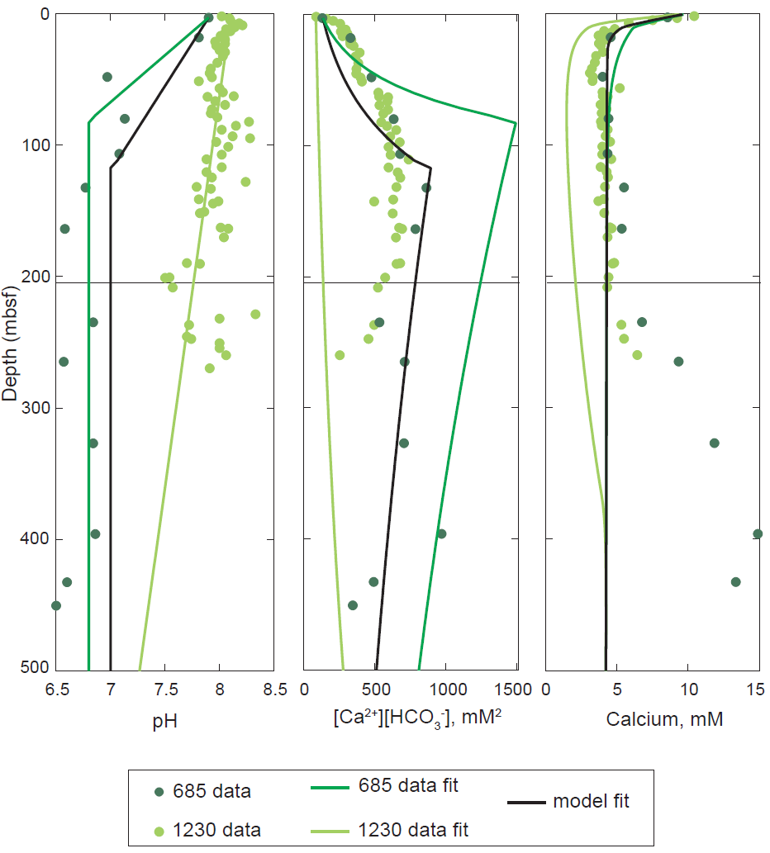
pH and activity correction
Chatterjee et al., (2012) to be submitted

Slide 28
Geotherm correction
Chatterjee et al., (2012) to be submitted

Slide 29
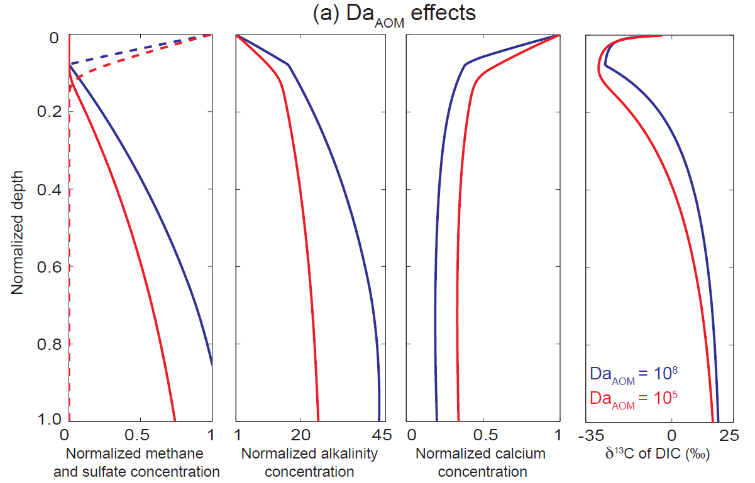
Effect of Da_{AOM}
Chatterjee et al., J. Geophys. Res., (2011)

Slide 30
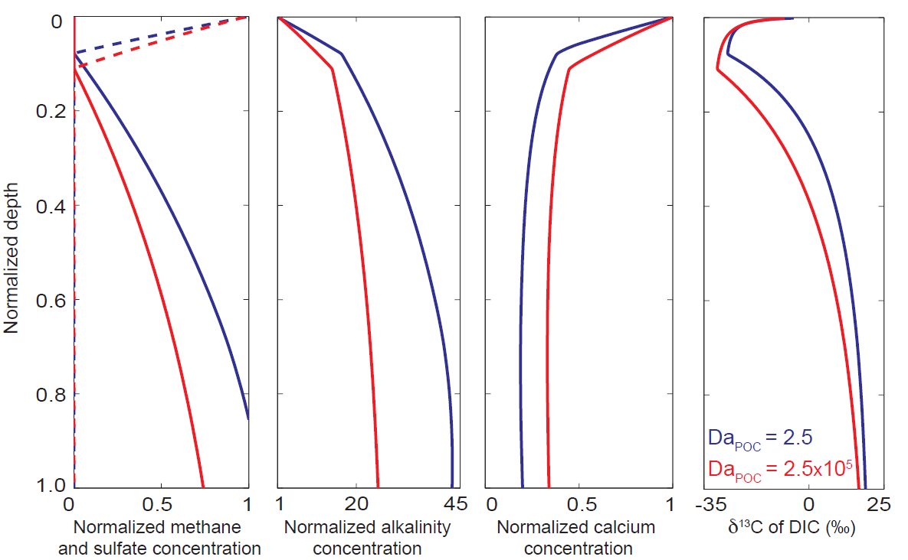
Effect of Da_{POC}
Chatterjee et al., J. Geophys. Res., (2011)

Slide 31
2:1 concentration crossplot
Chatterjee et al., J. Geophys. Res., (2011)

Slide 32
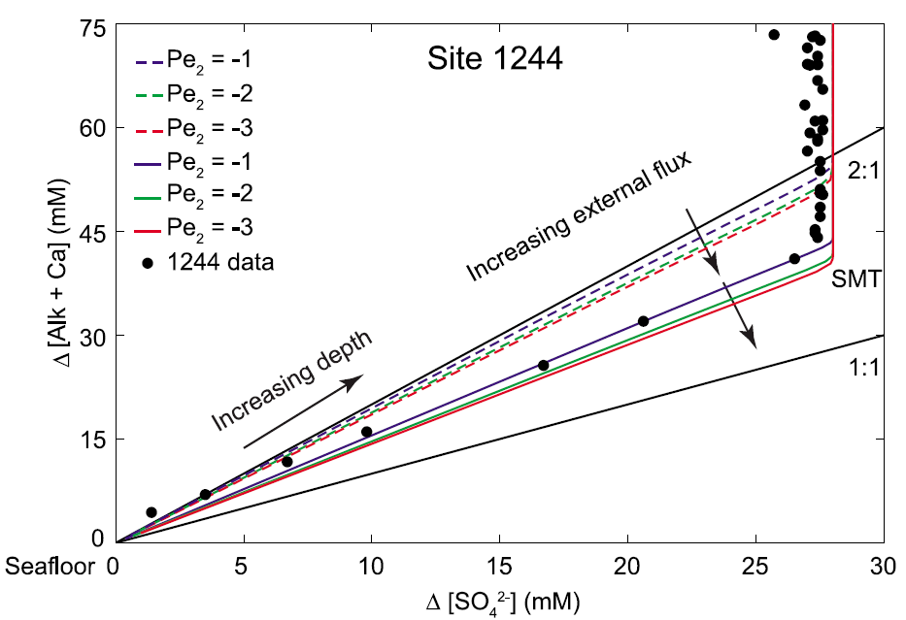
Concentration crossplot: Site 1244
Da = 1; C_{b,ext} = 50
Da = 0.22; C_{b,ext} = 27
Chatterjee et al., J. Geophys. Res., (2011)

Slide 33
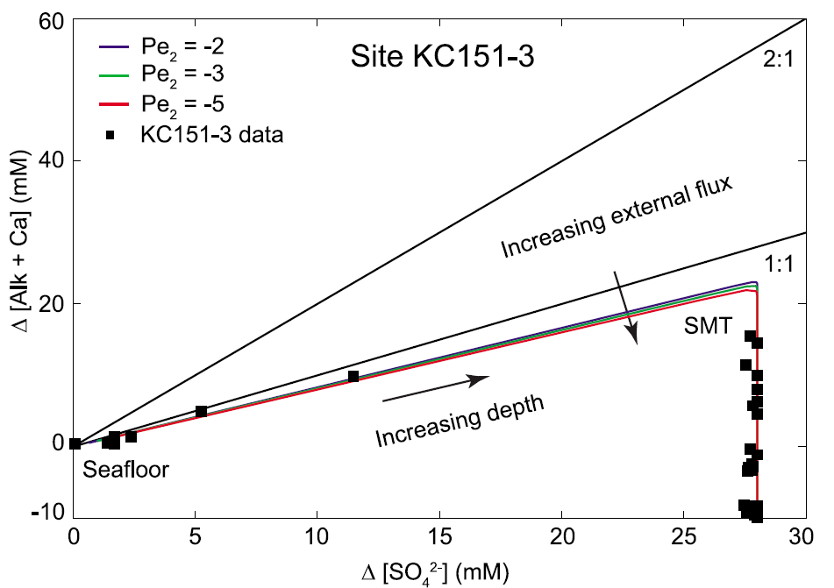
Concentration crossplot: Site KC151
Chatterjee et al., J. Geophys. Res., (2011)

Slide 34
Concentration crossplot: Site 1230
Chatterjee et al., (2012) to be submitted

Slide 35
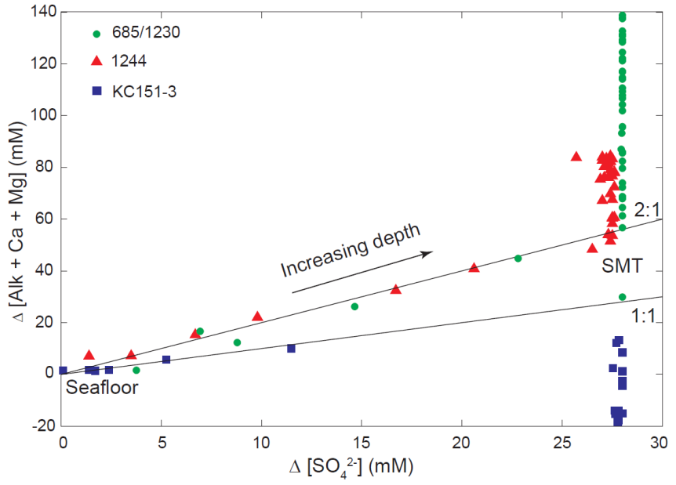
Concentration crossplots CANNOT determine stoichiometry
Site 685/1230
Chatterjee et al., J. Geophys. Res., (2011); Chatterjee et al., (2012) to be submitted

Slide 36
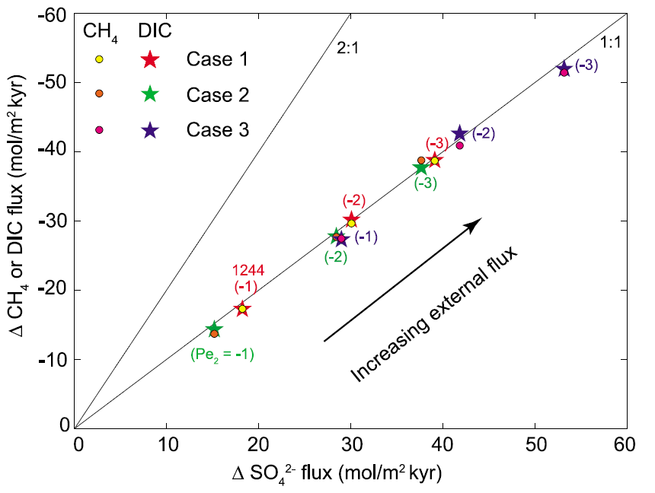
Flux crossplot: Site 1244
Chatterjee et al., J. Geophys. Res., (2011)

Slide 37
Flux crossplot: Site 1230
Chatterjee et al., (2012) to be submitted

Slide 38
Two potential causes for SMT
Anaerobic Oxidation of Methane (AOM)
                (1:1)
Organoclastic Sulfate Reduction (OSR)
(2:1)
= Dissolved Inorganic Carbon (DIC) ~ Alkalinity

Slide 39
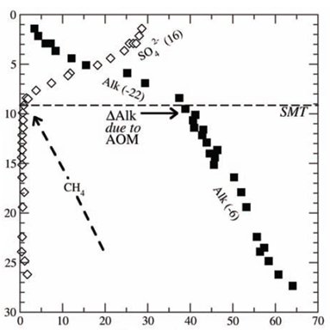
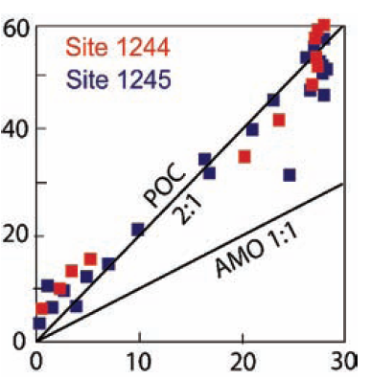
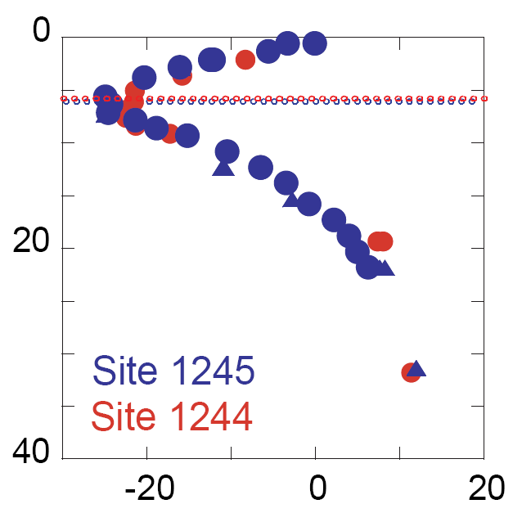
Arguments for OSR: Stoichiometry and δ¹³C of DIC
  OSR (2:1); δ¹³C_{DIC} ≈ -25‰ AOM (1:1); δ¹³C_{DIC} ≈ -60‰
Site 1244
∆ (Alk+Ca+Mg)
OSR
Depth (mbsf)
Depth (mbsf)
AOM
SO₄²⁻, Alkalinity (mM)
∆SO₄
δ¹³C_{DIC} (‰)
∆ = change from seawater
Kastner et al., Fire in the ice, (2008)

Slide 40
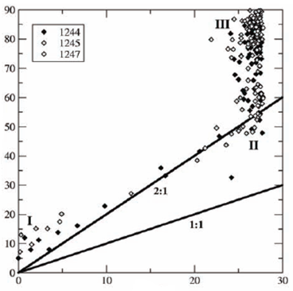
Counterarguments for AOM and methanogenesis
  OSR (2:1); δ¹³C_{DIC} ≈ -25‰ AOM (1:1); δ¹³C_{DIC} ≈ -60‰
  Methanogenesis; δ¹³C_{DIC} ≈ 10‰
Site 1244
-60‰ (AOM)
Depth (mbsf)
∆ (Alk+Ca+Mg)
Depth (mbsf)
+10‰
(methanogenesis)
SO₄²⁻, Alkalinity (mM)
∆SO₄
δ¹³C_{DIC} (‰)
Deep DIC flux is enriched in ¹³C
Flux units mol/m²kyr
Dickens and Snyder., Fire in the ice, (2009)

Slide 41
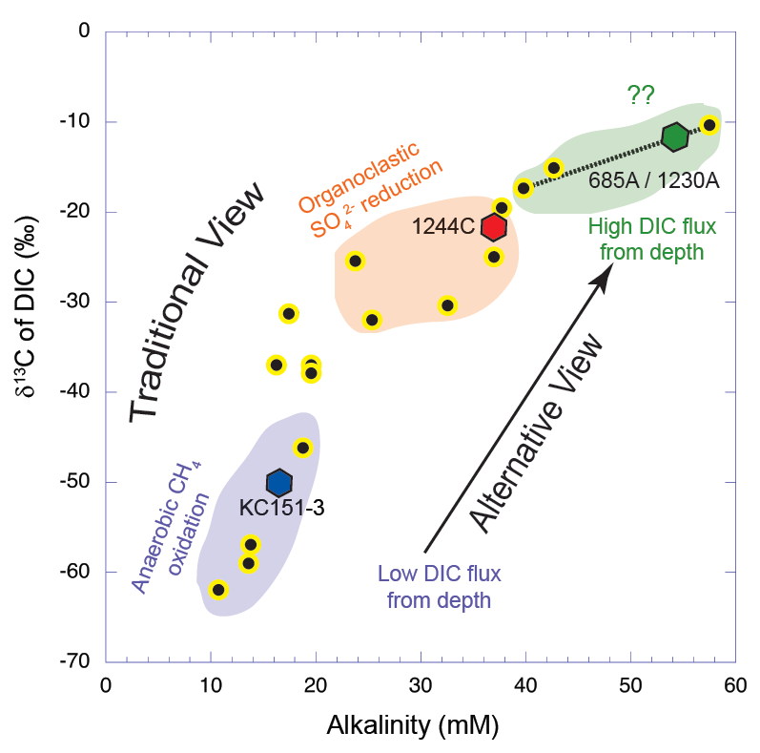
¹³C enriched DIC flux from depth impacts alkalinity and δ¹³C of DIC at SMT
  AOM (δ¹³C_{DIC} ≈ -60‰)
  Methanogenesis (δ¹³C_{DIC} ≈ 10‰)
  OSR (δ¹³C_{DIC} ≈ -25‰)
Chatterjee et al., J. Geophys. Res., (2011)

Slide 42
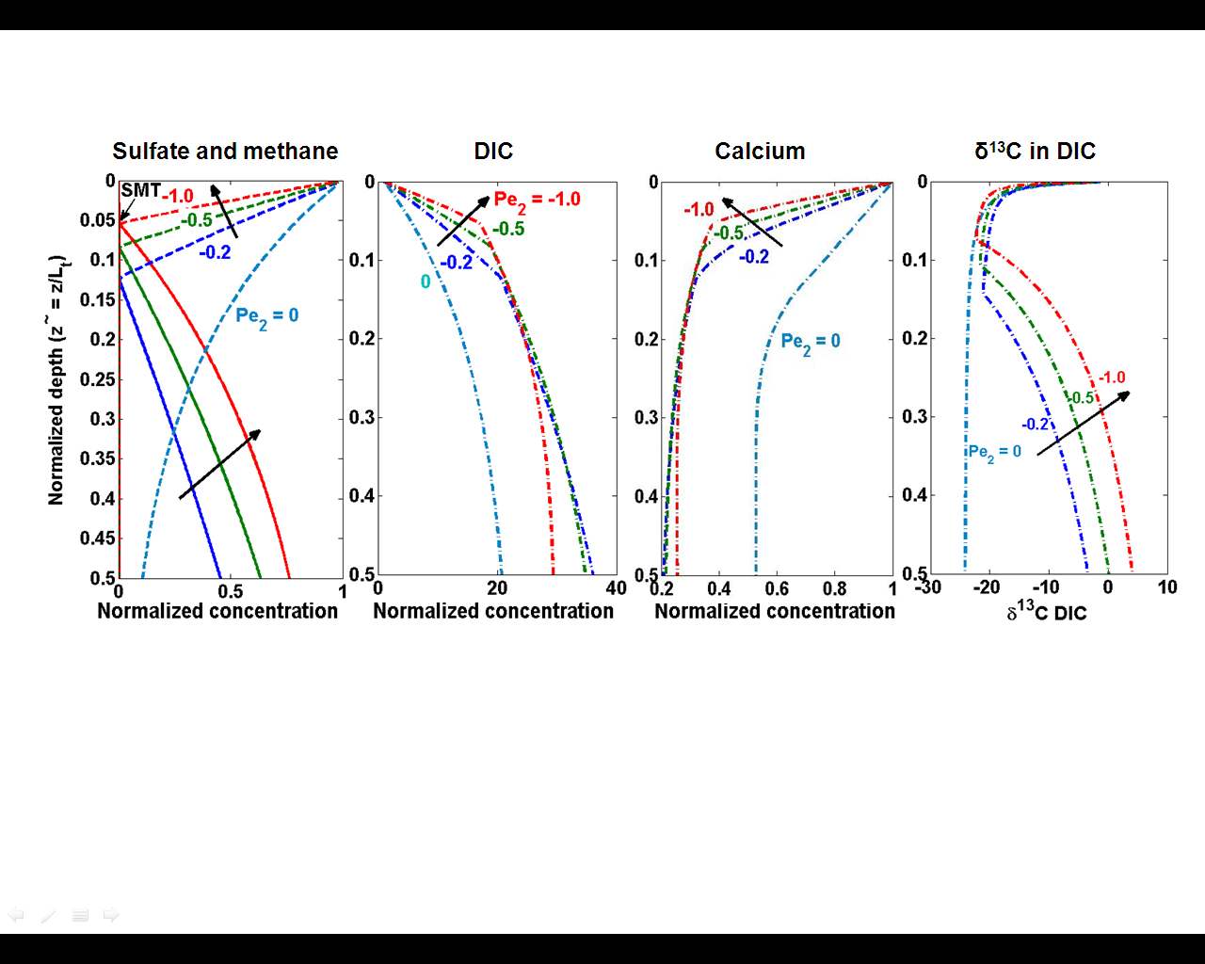
OSR dominated systems
  CH₄ and SO₄²⁻ DIC (or HCO₃⁻) Ca²⁺ δ¹³C in DIC

Slide 43
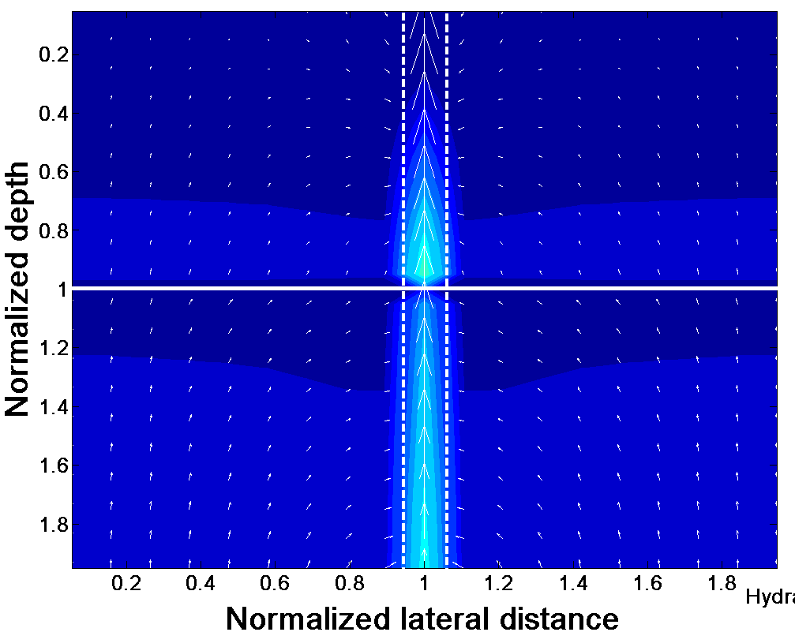
Distinct zones of local fluid flux
Seafloor
Low local fluid flux
Low local fluid flux
High local fluid flux
BHSZ

Slide 44
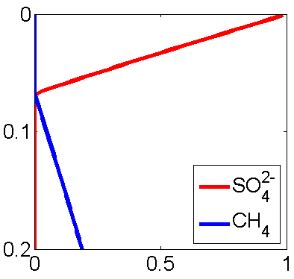
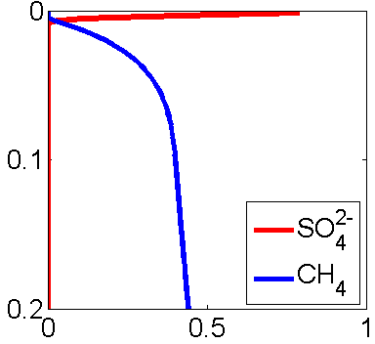
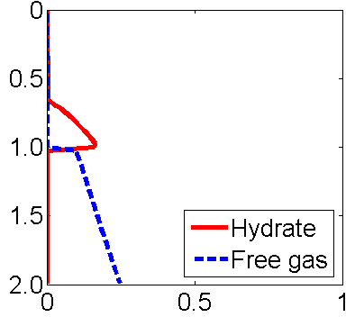
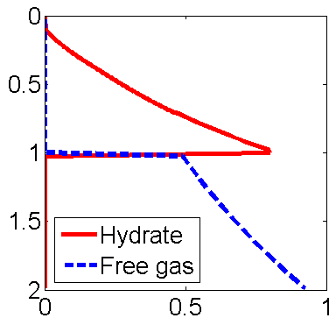
Local SMT depends on local fluid flux
Low flux in sediment High flux in fracture
Normalized depth
Normalized depth
Pe_{Local} = - 29
Pe_{Local} = - 0.85
SMT depth
Normalized concentration
Normalized concentration
BHSZ
BHSZ
Low flux in sediment High flux in fracture
Normalized depth
<S_{h}>_{Local} = 6%
Normalized depth
<S_{h}>_{Local} = 22%
Top of gas hydrate
Hydrate and free gas
Hydrate and free gas

Slide 45
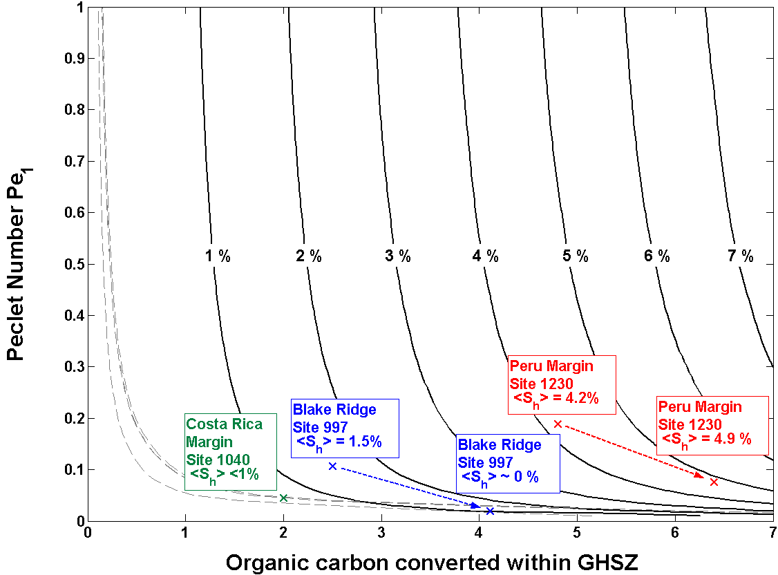
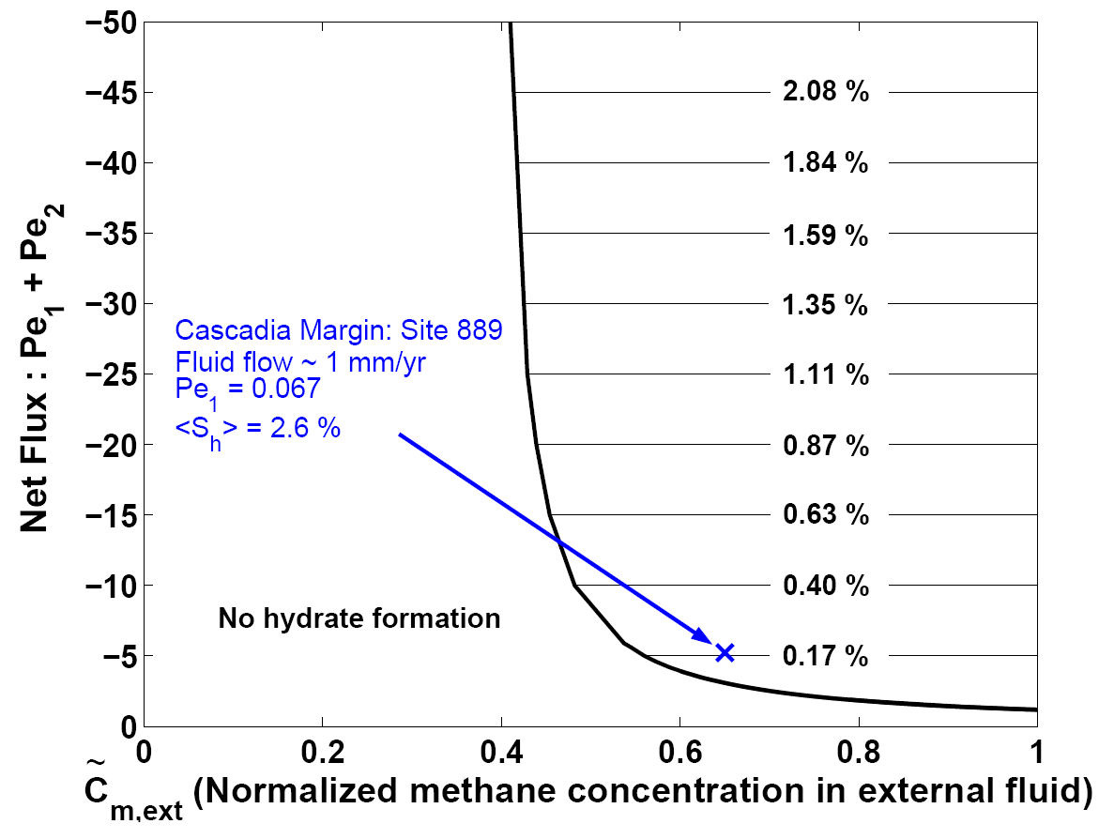
Generalized model to quantify amount and distribution of gas hydrates
Biogenic sources only Biogenic sources and external flux
Pe₁<S_{h}>
Net fluid flux (Pe₁)
and org C input at seafloor
Hydrate
saturation
Net fluid flux (Pe₁ + Pe₂)
Hydrate
saturation
Bhatnagar et al., Am. J. Sci., (2007)

Slide 46

Kinetic and equilibrium reaction model
Methanogenesis reaction:
AOM reaction at the SMT:
POC driven sulfate consumption above the SMT:
Calcite precipitation reaction:

Slide 47

δ¹³C definition
The isotopic carbon composition (δ¹³C ) in any sample is defined
The isotope ratios usually reported in per mille, relative to an standard Pee-Dee-Belemnite (PDB) marine carbonate

Slide 48

Reactions with corresponding δ¹³C values
Methanogenesis reaction:
AOM reaction of biogenic methane at the SMT:
Organoclastic sulfate consumption:
Calcite precipitation reaction:

Slide 49
1-D organic carbon mass balance
Dimensionless mass balance

Slide 50
1-D methane mass balance
Dimensionless mass balance

Slide 51
1-D sulfate mass balance
Dimensionless mass balance

Slide 52
1-D DIC mass balance
Dimensionless mass balance

Slide 53
1-D calcium mass balance
Dimensionless mass balance

Slide 54
1-D δ¹³C_{methane} mass balance
Dimensionless mass balance
.

Slide 55
1-D δ¹³C_{DIC} mass balance
Dimensionless mass balance

